Slide 1

Bash Shell
Embedded Linux
Module: Shell Programming

Slide 2
Agenda
What is a shell? A shell script?
Introduction to bash
Running Commands
Shell Structures
Applied Shell Programming

Slide 3
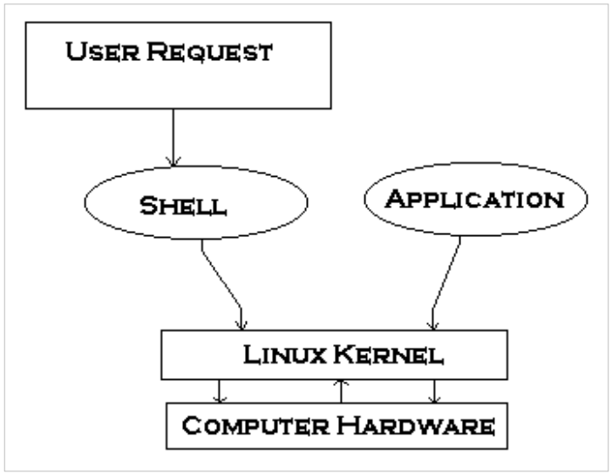
Introduction to Shell Programming
Computer understand the language of 0's and 1's called binary language.
In early days of computing, instruction are provided using binary language, which is difficult for all of us, to read and write. So in Os there is special program called Shell. Shell accepts your instruction or commands in English (mostly) and if its a valid command, it is passed to kernel.

Slide 4
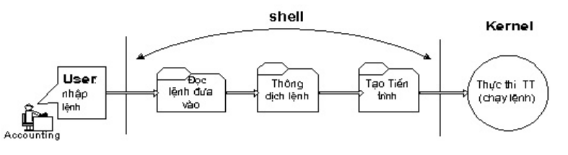
Introduction to Shell Programming
Shell is a user program or it's a environment provided for user interaction.
Shell is an command language interpreter that executes commands read from the standard input device (keyboard) or from a file.
Notes:
The C Shell
Copyright Department of Computer Science, Northern Illinois University, 2005

Slide 5
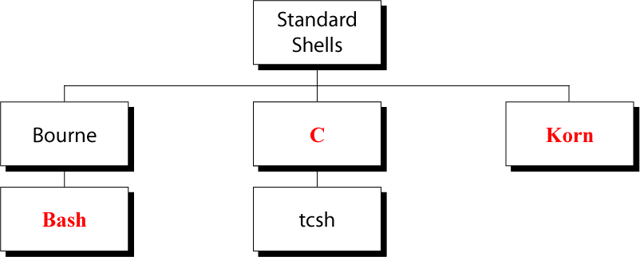
UNIX Command Interpreters
Linux has a variety of different shells:
  Bourne shell (sh), C shell (csh), Korn shell (ksh), TC shell (tcsh), Bourne Again shell (bash).
Certainly the most popular shell is “bash”. Bash is an sh-compatible shell
To find all available shells in your system type following command:
$ cat /etc/shells

Slide 6
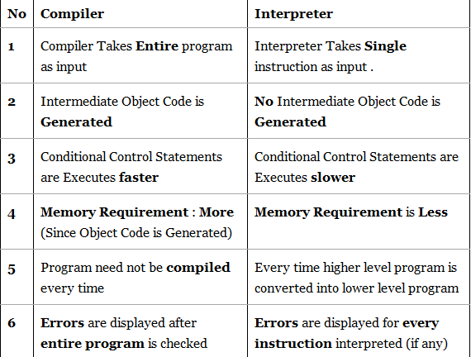
Programming or Scripting ?
bash is not only an excellent command line shell, but a scripting language in itself. Shell scripting allows us to use the shell's abilities and to automate a lot of tasks that would otherwise require a lot of commands.
Difference between programming and scripting languages:
Programming languages are generally a lot more powerful and a lot faster than scripting languages. Programming languages generally start from source code and are compiled into an executable. This executable is not easily ported into different operating systems.
A scripting language also starts from source code, but is not compiled into an executable. Rather, an interpreter reads the instructions in the source file and executes each instruction. Interpreted programs are generally slower than compiled programs. The main advantage is that you can easily port the source file to any operating system. bash is a scripting language. Other examples of scripting languages are Perl, Lisp, and Tcl.

Slide 7
What is Shell Script
Normally shells are interactive. It means shell accept command from you (via keyboard) and execute them.
But if you use command one by one (sequence of 'n' number of commands) , the you can store this sequence of command to text file and tell the shell to execute this text file instead of entering the commands. This is know as shell script.
Shell script defined as:
"Shell Script is series of command written in plain text file. Shell script is just like batch file is MS-DOS but have more power than the MS-DOS batch file."
Notes:
The C Shell
Copyright Department of Computer Science, Northern Illinois University, 2005

Slide 8
Shell Program Structure
A shell program contains high-level programming language features:
  Variables for storing data
  Decision-making control (e.g. if and case statements)
  Looping abilities (e.g. for and while loops)
  Function calls for modularity
Notes:
The C Shell
Copyright Department of Computer Science, Northern Illinois University, 2005

Slide 9
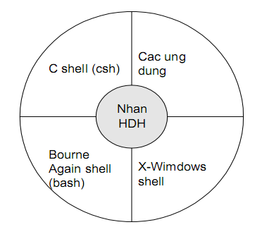
Steps to Create Shell Programs
Specify shell to execute program
  Script must begin with #! to identify shell to be executed
Examples:
    #! /bin/sh (defaults to bash)
    #! /bin/bash
    #! /bin/csh
    #! /usr/bin/tcsh
Make the shell program executable
  Use the “chmod” command to make the program/script file executable
Notes:
The C Shell
Copyright Department of Computer Science, Northern Illinois University, 2005

Slide 10
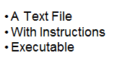
How to write shell script
(1) Use any editor like vi or pico, gedit to write shell script.
(2) After writing shell script set execute permission for your script as follows
syntax: chmod permission your-script-name
$ chmod +x your-script-name OR $ chmod 755 your-script-name
This will set read write execute (7) permission for owner, for group and other permission is read and execute only (5).
(3) Execute your script as syntax:
bash your-script-name
sh your-script-name
./your-script-name
$ bash bar
$ sh bar
$ ./bar
Notes:
The C Shell
Copyright Department of Computer Science, Northern Illinois University, 2005

Slide 11
Basic Shell Programming
A script is a file that contains
shell commands
data structure: variables
control structure: sequence, decision, loop
Input
  prompting user
  command line arguments
Decision:
  if-then-else
  case
Repetition
  do-while, repeat-until
  for
  select
Functions
Notes:
Shebang may refer to: Shebang (Unix), the #! syntax used in scripts to indicate an interpreter for execution
The Bash Shell
NIU Department of Computer Science
09-<number>

Slide 12
What is a Shell Script? What To Do
pico hello.sh
#!/bin/sh
echo ‘Hello, world’
% chmod +x hello.sh
% ./hello.sh
Hello, world

Slide 13
What is a Shell Script? Executable
pico hello.sh
#!/bin/sh
echo ‘Hello, world’
% chmod +x hello.sh
% ./hello.sh
Hello, world

Slide 14
What is a Shell Script? Running it
pico hello.sh
#!/bin/sh
echo ‘Hello, world’
% chmod +x hello.sh
% ./hello.sh
Hello, world

Slide 15
FORMATTING SHELL PROGRAMS
Comments
Start comment lines with a pound sign (#)
Include comments to describe sections of your program
Help you understand your program when you look at it later
Notes:
The C Shell
Copyright Department of Computer Science, Northern Illinois University, 2005

Slide 16
Single and Double Quote
When assigning character data containing spaces or special characters, the data must be enclosed in either single or double quotes.
Using double quotes to show a string of characters will allow any variables in the quotes to be resolved
$ var=“test string”
$ newvar=“Value of var is $var”
$ echo $newvar
Value of var is test string
Using single quotes to show a string of characters will not allow variable resolution
$ var=’test string’
$ newvar=’Value of var is $var’
$ echo $newvar
Value of var is $var

Slide 17
Command Substitution
The backquote “`” is different from the single quote “´”. It is used for command substitution: `command`
$ LIST=`ls`
$ echo $LIST
hello.sh read.sh
We can perform the command substitution by means of $(command)
$ LIST=$(ls)
$ echo $LIST
hello.sh read.sh
$ rm $( find / -name “*.tmp” )
$ cat backup.sh
#!/bin/bash
OF=myscript_directory_$(date +%Y%m%d).tar.gz
tar -czf $OF /usr/local
Notes:
Substitution: the use of one person or thing instead of another

Slide 18
The export command
The export command puts a variable into the environment so it will be accessible to child processes. For instance:
$ x=hello
$ bash # Run a child shell.
$ echo $x # Nothing in x.
$ exit # Return to parent.
$ export x
$ bash
$ echo $x
hello # It's there.
If the child modifies x, it will not modify the parent’s original value. Verify this by changing x in the following way:
$ x=ciao
$ exit
$ echo $x
hello

Slide 19
The Environment
The Unix system is controlled by a number of shell variables that are separately set by the system some during boot sequence, and some after logging in. These variables are called system variables or environment variables.
The set statement displays the complete list of all these variables. Built-in variable names are defined in uppercase.

Slide 20
The Environment
The PATH : is a variable that instructs the shell about the route it should follow to locate any executable command.
The HOME : when you log in, UNIX normally places you in a directory named after your login name.
The SHELL: determines the type of shell that a user sees on logging in.
.bash_profile : the script executed during login time. Every time you make changes to it, you should log out and log in again.
The .bash_profile must be located in your home directory, and it is executed after /etc/profile, the universal profile for all users. Universal environment settings are kept by the administrator in /etc/profile so that they are available to all users.

Slide 21
The Environment
ALIASES : it allows you to assign short-hand names for commands you may be using quite frequently. This is done with the alias statement. Consider following ex.
  $ alias l=‘ls -l’
Aliases are listed when the alias statement is used without argument.
The alias feature also allows you to incorporate positional parameters as variables in an alias.
For ex.
  $ alias showdir=‘cd $1 ; ls -l’
When you want to see the contents of the directory /home/arm

Slide 22
Environmental Variables
There are two types of variables:
Local variables
Environmental variables
Environmental variables are set by the system and can usually be found by using the env command. Environmental variables hold special values. For instance:
$ echo $SHELL
/bin/bash
$ echo $PATH
/usr/local/bin:/bin:/usr/bin
Environmental variables are defined in /etc/profile, /etc/profile.d/ and ~/.bash_profile. These files are the initialization files and they are read when bash shell is invoked.
When a login shell exits, bash reads ~/.bash_logout
The startup is more complex; for example, if bash is used interactively, then /etc/bashrc or ~/.bashrc are read. See the man page for more details.

Slide 23
Environmental Variables
HOME: The default argument (home directory) for cd.
PATH: The search path for commands. It is a colon-separated list of directories that are searched when you type a command.
LOGNAME: contains the user name
HOSTNAME: contains the computer name.
Usually, we type in the commands in the following way:
$ ./command
By setting PATH=$PATH:. our working directory is included in the search path for commands, and we simply type:
$ command
If we type in
$ mkdir ~/bin
and we include the following lines in the ~/.bash_profile:
PATH=$PATH:$HOME/bin
export PATH
we obtain that the directory /home/userid/bin is included in the search path for commands.

Slide 24
Read command
The read command allows you to prompt for input and store it in a variable.
Example:
#!/bin/bash
echo -n “Enter name of file to delete: ”
read file
echo “Type 'y' to remove it, 'n' to change your mind ... ”
rm -i $file
echo "That was YOUR decision!”
Line 2 prompts for a string that is read in line 3. Line 4 uses the interactive remove (rm -i) to ask the user for confirmation.

Slide 25
Variables
We can use variables as in any programming languages. Their values are always stored as strings, but there are mathematical operators in the shell language that will convert variables to numbers for calculations.
We have no need to declare a variable, just assigning a value to its reference will create it.
Example
#!/bin/bash
STR=“Hello World!”
echo $STR
Line 2 creates a variable called STR and assigns the string "Hello World!" to it. Then the value of this variable is retrieved by putting the '$' in at the beginning.

Slide 26
Warning !
The shell programming language does not type-cast its variables. This means that a variable can hold number data or character data.
count=0
count=Sunday
Switching the TYPE of a variable can lead to confusion for the writer of the script or someone trying to modify it, so it is recommended to use a variable for only a single TYPE of data in a script.

Slide 27
Examples: Command Line Arguments
% set tim bill ann fred
$1 $2 $3 $4
% echo $*
tim bill ann fred
% echo $#
4
% echo $1
tim
% echo $3 $4
ann fred
The ‘set’ command can be used to assign values to positional parameters

Slide 28
Arithmetic Evaluation
The let statement can be used to do mathematical functions:
$ let X=10+2*7
$ echo $X
24
$ let Y=X+2*4
$ echo $Y
32
An arithmetic expression can be evaluated by $[expression] or $((expression))
$ echo “$((123+20))”
143
$ VALORE=$[123+20]
$ echo “$[123*$VALORE]”
17589

Slide 29
Arithmetic Evaluation
Available operators: +, -, /, *, %
Example
$ cat arithmetic.sh
#!/bin/bash
echo -n “Enter the first number: ”; read x
echo -n “Enter the second number: ”; read y
add=$(($x + $y))
sub=$(($x - $y))
mul=$(($x * $y))
div=$(($x / $y))
mod=$(($x % $y))
# print out the answers:
echo “Sum: $add”
echo “Difference: $sub”
echo “Product: $mul”
echo “Quotient: $div”
echo “Remainder: $mod”

Slide 30
Conditional Statements
Conditionals let us decide whether to perform an action or not, this decision is taken by evaluating an expression. The most basic form is:
if [ expression ];
then
statements
elif [ expression ];
then
statements
else
statements
fi
the elif (else if) and else sections are optional
Put spaces after [ and before ], and around the operators and operands.

Slide 31
Expressions
An expression can be: String comparison, Numeric comparison, File operators and Logical operators and it is represented by [expression]:
String Comparisons:
= compare if two strings are equal
!= compare if two strings are not equal
-n evaluate if string length is greater than zero
-z evaluate if string length is equal to zero
Examples:
[ s1 = s2 ] (true if s1 same as s2, else false)
[ s1 != s2 ] (true if s1 not same as s2, else false)
[ s1 ] (true if s1 is not empty, else false)
[ -n s1 ] (true if s1 has a length greater then 0, else false)
[ -z s2 ] (true if s2 has a length of 0, otherwise false)

Slide 32
Expressions
Number Comparisons:
-eq compare if two numbers are equal
-ge compare if one number is greater than or equal to a number
-le compare if one number is less than or equal to a number
-ne compare if two numbers are not equal
-gt compare if one number is greater than another number
-lt compare if one number is less than another number
Examples:
[ n1 -eq n2 ] (true if n1 same as n2, else false)
[ n1 -ge n2 ] (true if n1greater then or equal to n2, else false)
[ n1 -le n2 ] (true if n1 less then or equal to n2, else false)
[ n1 -ne n2 ] (true if n1 is not same as n2, else false)
[ n1 -gt n2 ] (true if n1 greater then n2, else false)
[ n1 -lt n2 ] (true if n1 less then n2, else false)

Slide 33
Relational Operators
Meaning | Numeric | String
Greater than | -gt
Greater than or equal | -ge
Less than | -lt
Less than or equal | -le
Equal | -eg | = or ==
Not equal | -ne | !=
str1 is less than str2 |  | str1 < str2
str1 is greater str2 |  | str1 > str2
String length is greater than zero |  | -n str
String length is zero |  | -z str

Slide 34
Examples
$ cat user.sh
#!/bin/bash
echo -n “Enter your login name: "
read name
if [ “$name” = “$USER” ];
then
echo “Hello, $name. How are you today ?”
else
echo “You are not $USER, so who are you ?”
fi
$ cat number.sh
#!/bin/bash
echo -n “Enter a number 1 < x < 10: "
read num
if [ “$num” -lt 10 ]; then
if [ “$num” -gt 1 ]; then
echo “$num*$num=$(($num*$num))”
else
echo “Wrong insertion !”
fi
else
echo “Wrong insertion !”
fi

Slide 35
Expressions
Files operators:
-d check if path given is a directory
-f check if path given is a file
-e check if file name exists
-r check if read permission is set for file or directory
-s check if a file has a length greater than 0
-w check if write permission is set for a file or directory
-x check if execute permission is set for a file or directory
Examples:
[ -d fname ] (true if fname is a directory, otherwise false)
[ -f fname ] (true if fname is a file, otherwise false)
[ -e fname ] (true if fname exists, otherwise false)
[ -s fname ] (true if fname length is greater then 0, else false)
[ -r fname ] (true if fname has the read permission, else false)
[ -w fname ] (true if fname has the write permission, else false)
[ -x fname ] (true if fname has the execute permission, else false)

Slide 36
Example
#!/bin/bash
if [ -f /etc/fstab ];
then
cp /etc/fstab .
echo “Done.”
else
echo “This file does not exist.”
exit 1
fi
Exercise.
Write a shell script which:
  accepts a file name
  checks if file exists
  if file exists, copy the file to the same name + the current date (if the backup file already exists ask if you want to replace it).
When done you should have the original file and one with a current date at the end.

Slide 37
Expressions
Logical operators:
! negate (NOT) a logical expression
-a logically AND two logical expressions
-o logically OR two logical expressions
Example:
#!/bin/bash
echo -n “Enter a number 1 < x < 10:”
read num
if [ “$num” -gt 1 -a “$num” -lt 10 ];
then
echo “$num*$num=$(($num*$num))”
else
echo “Wrong insertion !”
fi

Slide 38
Expressions
Logical operators:
&& logically AND two logical expressions
|| logically OR two logical expressions
Example:
#!/bin/bash
echo -n "Enter a number 1 < x < 10: "
read num
if [ “$number” -gt 1 ] && [ “$number” -lt 10 ];
then
echo “$num*$num=$(($num*$num))”
else
echo “Wrong insertion !”
fi

Slide 39
Example
$ cat iftrue.sh
#!/bin/bash
echo “Enter a path: ”; read x
if cd $x; then
echo “I am in $x and it contains”; ls
else
echo “The directory $x does not exist”;
exit 1
fi

Slide 40
Shell Parameters
Positional parameters are assigned from the shell’s argument when it is invoked. Positional parameter “N” may be referenced as “${N}”, or as “$N” when “N” consists of a single digit.
Special parameters
$# is the number of parameters passed
$0 returns the name of the shell script running as well as its
location in the file system
$* gives a single word containing all the parameters passed
to the script
$@ gives an array of words containing all the parameters
passed to the script
$ cat sparameters.sh
#!/bin/bash
echo “$#; $0; $1; $2; $*; $@”
$ sparameters.sh arg1 arg2
2; ./sparameters.sh; arg1; arg2; arg1 arg2; arg1 arg2

Slide 41
Special shell variables
Parameter | Meaning
$0 | Name of the current shell script
$1-$9 | Positional parameters 1 through 9
$# | The number of positional parameters
$* | All positional parameters, “$*” is one string
$@ | All positional parameters, “$@” is a set of strings
$? | Return status of most recently executed command
$$ | Process id of current process
#! /bin/bash
if [ $# -lt 1 ]; then
echo "Usage: filetest filename"
exit 1
fi

Slide 42
Trash
$ cat trash.sh
#!/bin/bash
if [ $# -eq 1 ];
then
if [ ! –d “$HOME/trash” ];
then
mkdir “$HOME/trash”
fi
mv $1 “$HOME/trash”
else
echo “Use: $0 filename”
exit 1
fi
Notes:
terminates the shell script using exit 1 statement
(1) If return value is zero (0), command is successful.
(2) If return value is nonzero, command is not successful or some sort of error executing command/shell script.

Slide 43
Case Statement
Used to execute statements based on specific values. Often used in place of an if statement if there are a large number of conditions.
Value used can be an expression
each set of statements must be ended by a pair of semicolons;
a *) is used to accept any value not matched with list of values
case $var in
val1)
statements;;
val2)
statements;;
*)
statements;;
esac

Slide 44
Example 1 (case.sh)
$ cat case.sh
#!/bin/bash
echo -n “Enter a number 1 < x < 10: ”
read x
case $x in
1) echo “Value of x is 1.”;;
2) echo “Value of x is 2.”;;
3) echo “Value of x is 3.”;;
4) echo “Value of x is 4.”;;
5) echo “Value of x is 5.”;;
6) echo “Value of x is 6.”;;
7) echo “Value of x is 7.”;;
8) echo “Value of x is 8.”;;
9) echo “Value of x is 9.”;;
0 | 10) echo “wrong number.”;;
*) echo “Unrecognized value.”;;
esac

Slide 45
Example 2: The case Statement
#!/bin/bash
echo "Enter Y to see all files including hidden files"
echo "Enter N to see all non-hidden files"
echo "Enter q to quit"
read -p "Enter your choice: " reply
case $reply in
Y|YES) echo "Displaying all (really…) files"
ls -a ;;
N|NO) echo "Display all non-hidden files..."
ls ;;
Q) exit 0 ;;
*) echo "Invalid choice!"; exit 1 ;;
esac

Slide 46
Example 3: The case Statement
#!/bin/bash
ChildRate=3
AdultRate=10
SeniorRate=7
read -p "Enter your age: " age
case $age in
[1-9]|[1][0-2]) # child, if age 12 and younger
echo "your rate is" '$'"$ChildRate.00" ;;
# adult, if age is between 13 and 59 inclusive
[1][3-9]|[2-5][0-9])
echo "your rate is" '$'"$AdultRate.00" ;;
[6-9][0-9]) # senior, if age is 60+
echo "your rate is" '$'"$SeniorRate.00" ;;
esac

Slide 47
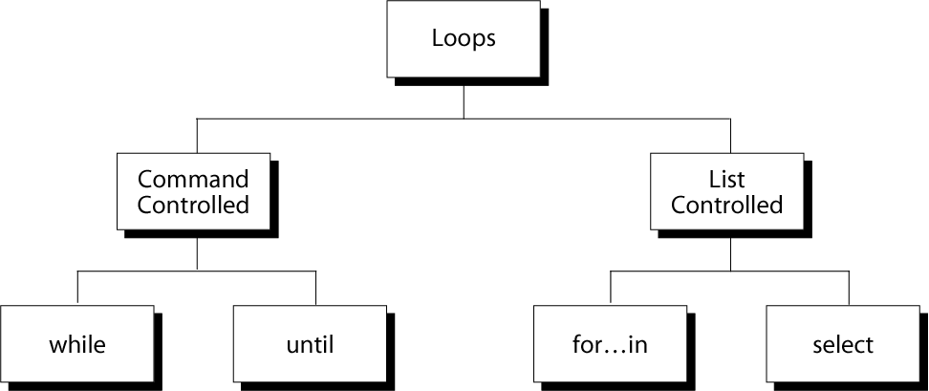
Repetition Constructs

Slide 48
Iteration Statements
The for structure is used when you are looping through a range of variables.
for var in list
do
statements
done
statements are executed with var set to each value in the list.
Example
#!/bin/bash
let sum=0
for num in 1 2 3 4 5
do
let “sum = $sum + $num”
done
echo $sum

Slide 49
Iteration Statements
#!/bin/bash
for x in paper pencil pen
do
echo “The value of variable x is: $x”
sleep 1
done
if the list part is left off, var is set to each parameter passed to the script ( $1, $2, $3,…)
$ cat for1.sh
#!/bin/bash
for x
do
echo “The value of variable x is: $x”
sleep 1
done
$ for1.sh arg1 arg2
The value of variable x is: arg1
The value of variable x is: arg2

Slide 50
Example (old.sh)
$ cat old.sh
#!/bin/bash
# Move the command line arg files to old directory.
if [ $# -eq 0 ] #check for command line arguments
then
echo “Usage: $0 file …”
exit 1
fi
if [ ! –d “$HOME/old” ]
then
mkdir “$HOME/old”
fi
echo The following files will be saved in the old directory:
echo $*
for file in $* #loop through all command line arguments
do
mv $file “$HOME/old/”
chmod 400 “$HOME/old/$file”
done
ls -l “$HOME/old”

Slide 51
Example (args.sh)
$ cat args.sh
#!/bin/bash
# Invoke this script with several arguments: “one two three“
if [ ! -n “$1” ]; then
echo “Usage: $0 arg1 arg2 ..." ; exit 1
fi
echo ; index=1 ;
echo “Listing args with \”\$*\”:”
for arg in “$*” ;
do
echo “Arg $index = $arg”
let “index+=1” # increase variable index by one
done
echo “Entire arg list seen as single word.”
echo ; index=1 ;
echo “Listing args with \”\$@\”:”
for arg in “$@” ; do
echo “Arg $index = $arg”
let “index+=1”
done
echo “Arg list seen as separate words.” ; exit 0

Slide 52
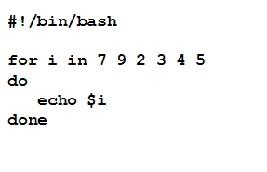
Logic: for
for i in /*
do
echo “Listing $i:”
ls -l $i
read
done

Slide 53
Example 2: Using the for Loop
#!/bin/bash
# compute the average weekly temperature
for num in 1 2 3 4 5 6 7
do
read -p "Enter temp for day $num: " Temp
let TempTotal=$TempTotal+$Temp
done
let AvgTemp=$TempTotal/7
echo "Average temperature: " $AvgTemp

Slide 54
A C-like for loop
An alternative form of the for structure is
for (( EXPR1 ; EXPR2 ; EXPR3 ))
do
statements
done
First, the arithmetic expression EXPR1 is evaluated. EXPR2 is then evaluated repeatedly until it evaluates to 0. Each time EXPR2 is evaluates to a non-zero value, statements are executed and EXPR3 is evaluated.
$ cat for2.sh
#!/bin/bash
echo –n “Enter a number: ”; read x
let sum=0
for (( i=1 ; $i<$x ; i=$i+1 )) ; do
let “sum = $sum + $i”
done
echo “the sum of the first $x numbers is: $sum”

Slide 55
While Statements
The while structure is a looping structure. Used to execute a set of commands while a specified condition is true. The loop terminates as soon as the condition becomes false. If condition never becomes false, loop will never exit.
while expression
do
statements
done
$ cat while.sh
#!/bin/bash
echo –n “Enter a number: ”; read x
let sum=0; let i=1
while [ $i –le $x ]; do
let “sum = $sum + $i”
i=$i+1
done
echo “the sum of the first $x numbers is: $sum”

Slide 56
Example: Using the while Loop
#!/bin/bash
COUNTER=0
while [ $COUNTER -lt 10 ]
do
echo The counter is $COUNTER
let COUNTER=$COUNTER+1
done

Slide 57
Menu
$ cat menu.sh
#!/bin/bash
clear ; loop=y
while [ “$loop” = y ] ;
do
echo “Menu”; echo “====”
echo “D: print the date”
echo “W: print the users who are currently log on.”
echo “P: print the working directory”
echo “Q: quit.”
echo
read –s choice # silent mode: no echo to terminal
case $choice in
D | d) date ;;
W | w) who ;;
P | p) pwd ;;
Q | q) loop=n ;;
*) echo “Illegal choice.” ;;
esac
echo
done

Slide 58
Find a Pattern and Edit
$ cat grepedit.sh
#!/bin/bash
# Edit argument files $2 ..., that contain pattern $1
if [ $# -le 1 ]
then
echo “Usage: $0 pattern file …” ; exit 1
else
pattern=$1 # Save original $1
shift # shift the positional parameter to the left by 1
while [ $# -gt 0 ] # New $1 is first filename
do
grep “$pattern” $1 > /dev/null
if [ $? -eq 0 ] ; then # If grep found pattern
vi $1 # then vi the file
fi
shift
done
fi
$ grepedit.sh while ~

Slide 59
Example: Using the while Loop
#!/bin/bash
# copies files from home- into the webserver- directory
# A new directory is created every hour
PICSDIR=/home/carol/pics
WEBDIR=/var/www/carol/webcam
while true; do
DATE=`date +%Y%m%d`
HOUR=`date +%H`
mkdir $WEBDIR/"$DATE"
while [ $HOUR -ne "00" ]; do
DESTDIR=$WEBDIR/"$DATE"/"$HOUR"
mkdir "$DESTDIR"
mv $PICSDIR/*.jpg "$DESTDIR"/
sleep 3600
HOUR=`date +%H`
done
done

Slide 60
Continue Statements
The continue command causes a jump to the next iteration of the loop, skipping all the remaining commands in that particular loop cycle.
$ cat continue.sh
#!/bin/bash
LIMIT=19
echo
echo “Printing Numbers 1 through 20 (but not 3 and 11)”
a=0
while [ $a -le “$LIMIT” ]; do
a=$(($a+1))
if [ “$a” -eq 3 ] || [ “$a” -eq 11 ]
then
continue
fi
echo -n “$a ”
done

Slide 61
The continue
while [ condition ]
do
cmd-1
continue
cmd-n
done
echo "done"
This iteration is over; do the next iteration
Notes:
The Bash Shell
Copyright Department of Computer Science, Northern Illinois University, 2005
09-<number>

Slide 62
Break Statements
The break command terminates the loop (breaks out of it).
$ cat break.sh
#!/bin/bash
LIMIT=19
echo
echo “Printing Numbers 1 through 20, but something happens after 2 … ”
a=0
while [ $a -le “$LIMIT” ]
do
a=$(($a+1))
if [ “$a” -gt 2 ]
then
break
fi
echo -n “$a ”
done
echo; echo; echo
exit 0

Slide 63
The break
while [ condition ]
do
cmd-1
break
cmd-n
done
echo "done"
This iteration is over and there are no more iterations
Notes:
The Bash Shell
Copyright Department of Computer Science, Northern Illinois University, 2005
09-<number>

Slide 64
Example:
for index in 1 2 3 4 5 6 7 8 9 10
do
if [ $index –le 3 ]; then
echo "continue"
continue
fi
echo $index
if [ $index –ge 8 ]; then
echo "break"
break
fi
done

Slide 65
Until Statements
The until structure is very similar to the while structure. The until structure loops until the condition is true. So basically it is “until this condition is true, do this”.
until [expression]
do
statements
done
$ cat countdown.sh
#!/bin/bash
echo “Enter a number: ”; read x
echo ; echo Count Down
until [ “$x” -le 0 ]; do
echo $x
x=$(($x –1))
sleep 1
done
echo ; echo GO !

Slide 66
Example: Using the until Loop
#!/bin/bash
Stop="N"
until [ $Stop = "Y" ]; do
ps -A
read -p "want to stop? (Y/N)" reply
Stop=`echo $reply | tr [:lower:] [:upper:]`
done
echo "done"

Slide 67
Manipulating Strings
Bash supports a number of string manipulation operations.
${#string} gives the string length
${string:position} extracts sub-string from $string at $position
${string:position:length} extracts $length characters of sub-string from $string at $position
Example
$ st=0123456789
$ echo ${#st}
10
$ echo ${st:6}
6789
$ echo ${st:6:2}
67

Slide 68
Parameter Substitution
Manipulating and/or expanding variables
${parameter-default}, if parameter not set, use default.
$ echo ${username-`whoami`}
alice
$ username=bob
$ echo ${username-`whoami`}
bob
${parameter=default}, if parameter not set, set it to default.
$ unset username
$ echo ${username=`whoami`}
$ echo $username
alice
${parameter+value}, if parameter set, use value, else use null string.
$ echo ${username+bob}
bob

Slide 69
Parameter Substitution
${parameter?msg}, if parameter set, use it, else print msg
$ value=${total?’total is not set’}
total: total is not set
$ total=10
$ value=${total?’total is not set’}
$ echo $value
10
Example
#!/bin/bash
OUTFILE=symlinks.list # save file
directory=${1-`pwd`}
for file in “$( find $directory -type l )”
# -type l == symbolic links
do
echo “$file”
done | sort >> “$HOME/$OUTFILE”
exit 0

Slide 70
Functions
Functions make scripts easier to maintain. Basically it breaks up the program into smaller pieces. A function performs an action defined by you, and it can return a value if you wish.
#!/bin/bash
hello()
{
echo “You are in function hello()”
}
echo “Calling function hello()…”
hello
echo “You are now out of function hello()”
In the above, we called the hello() function by name by using the line: hello . When this line is executed, bash searches the script for the line hello(). It finds it right at the top, and executes its contents.

Slide 71
Functions
A shell function is similar to a shell script
  stores a series of commands for execution later
  shell stores functions in memory
  shell executes a shell function in the same shell that called it
must be defined before they can be referenced
usually placed at the beginning of the script
Syntax:
  function-name () {
  statements
  }

Slide 72
Example: function
#!/bin/bash
funky () {
# This is a simple function
echo "This is a funky function."
echo "Now exiting funky function."
}
# declaration must precede call:
funky

Slide 73
Functions
$ cat function.sh
#!/bin/bash
function check() {
if [ -e "/home/$1" ]
then
return 0
else
return 1
fi
}
echo “Enter the name of the file: ” ; read x
if check $x
then
echo “$x exists !”
else
echo “$x does not exists !”
fi.

Slide 74
Example: Picking a random card from a deck
#!/bin/bash
# Count how many elements.
Suites=“Clubs Diamonds Hearts Spades”
Denominations=“2 3 4 5 6 7 8 9 10 Jack Queen King Ace”
# Read into array variable.
suite=($Suites)
denomination=($Denominations)
# Count how many elements.
num_suites=${#suite[*]}
num_denominations=${#denomination[*]}
echo -n "${denomination[$((RANDOM%num_denominations))]} of "
echo ${suite[$((RANDOM%num_suites))]}
exit 0

Slide 75
Example: Changes all filenames to lowercase
#!/bin/bash
for filename in *
# Traverse all files in directory.
do
# Get the file name without the path.
fname=`basename $filename`
# Change name to lowercase.
n=`echo $fname | tr A-Z a-z`
if [ “$fname” != “$n” ]
# Rename only files not already lowercase.
then
mv $fname $n
fi
done
exit 0

Slide 76
Example: Compare two files with a script
#!/bin/bash
ARGS=2 # Two args to script expected.
if [ $# -ne “$ARGS” ]; then
echo “Usage: `basename $0` file1 file2” ; exit 1
fi
if [[ ! -r "$1" || ! -r "$2" ]] ; then
echo “Both files must exist and be readable.” ; exit 2
fi
# /dev/null buries the output of the “cmp” command.
cmp $1 $2 &> /dev/null
# Also works with 'diff', i.e., diff $1 $2 &> /dev/null
if [ $? -eq 0 ] # Test exit status of “cmp” command.
then
echo “File \“$1\” is identical to file \“$2\”.”
else
echo “File \“$1\“ differs from file \“$2\”.”
fi
exit 0

Slide 77
Function parameters
Need not be declared
Arguments provided via function call are accessible inside function as $1, $2, $3, …
$# reflects number of parameters
$0 still contains name of script
(not name of function)

Slide 78
Example: function with parameter
#! /bin/sh
testfile() {
if [ $# -gt 0 ]; then
if [[ -f $1 && -r $1 ]]; then
echo $1 is a readable file
else
echo $1 is not a readable file
fi
fi
}
testfile .
testfile funtest

Slide 79
Example: function with parameters
#! /bin/bash
checkfile() {
for file
do
if [ -f "$file" ]; then
echo "$file is a file"
else
if [ -d "$file" ]; then
echo "$file is a directory"
fi
fi
done
}
checkfile . funtest

Slide 80
Local Variables in Functions
Variables defined within functions are global,
i.e. their values are known throughout the entire shell program
keyword “local” inside a function definition makes referenced variables “local” to that function

Slide 81
Example: function
#! /bin/bash
global="pretty good variable"
foo () {
local inside="not so good variable"
echo $global
echo $inside
global="better variable"
}
echo $global
foo
echo $global
echo $inside

Slide 82
Using Arrays with Loops
In the bash shell, we may use arrays. The simplest way to create one is using one of the two subscripts:
pet[0]=dog
pet[1]=cat
pet[2]=fish
pet=(dog cat fish)
We may have up to 1024 elements. To extract a value, type ${arrayname[i]}
$ echo ${pet[0]}
dog
To extract all the elements, use an asterisk as:
echo ${arrayname[*]}
We can combine arrays with loops using a for loop:
for x in ${arrayname[*]}
do
...
done

Slide 83
Debugging
Bash provides two options which will give useful information for debugging
-x : displays each line of the script with variable substitution and before execution
-v : displays each line of the script as typed before execution
Usage:
#!/bin/bash –v or #!/bin/bash –x or #!/bin/bash –xv
$ cat for3.sh
#!/bin/bash –x
echo –n “Enter a number: ”; read x
let sum=0
for (( i=1 ; $i<$x ; i=$i+1 )) ; do
let “sum = $sum + $i”
done
echo “the sum of the first $x numbers is: $sum”

Slide 84
Debugging
$ for3.sh
+ echo –n ‘Enter a number: ’
Enter a number: + read x
3
+ let sum=0
+ (( i=0 ))
+ (( 0<=3 ))
+ let ‘sum = 0 + 0’
+ (( i=0+1 ))
+ (( 1<=3 ))
+ let ‘sum = 0 + 1’
+ (( i=1+1 ))
+ (( 2<=3 ))
+ let ‘sum = 1 + 2’
+ (( i=2+1 ))
+ (( 3<=3 ))
+ let ‘sum = 3 + 3’
+ (( i=3+1 ))
+ (( 4<=3 ))
+ echo ‘the sum of the first 3 numbers is: 6’
the sum of the first 3 numbers is: 6

Slide 85
Example: Suite drawing statistics
$ cat cardstats.sh
#!/bin/sh # -xv
N=100000
hits=(0 0 0 0) # initialize hit counters
if [ $# -gt 0 ]; then # check whether there is an argument
N=$1
else # ask for the number if no argument
echo "Enter the number of trials: "
TMOUT=5 # 5 seconds to give the input
read N
fi
i=$N
echo "Generating $N random numbers... please wait."
SECONDS=0 # here is where we really start
while [ $i -gt 0 ]; do # run until the counter gets to zero
case $((RANDOM%4)) in # randmize from 0 to 3
0) let "hits[0]+=1";; # count the hits
1) let "hits[1]=${hits[1]}+1";;
2) let hits[2]=$((${hits[2]}+1));;
3) let hits[3]=$((${hits[3]}+1));;
esac
let "i-=1” # count down
done
echo "Probabilities of drawing a specific color:"
# use bc - bash does not support fractions
echo "Clubs: " `echo ${hits[0]}*100/$N | bc -l`
echo "Diamonds: " `echo ${hits[1]}*100/$N | bc -l`
echo "Hearts: " `echo ${hits[2]}*100/$N | bc -l`
echo "Spades: " `echo ${hits[3]}*100/$N | bc -l`
echo "=========================================="
echo "Execution time: $SECONDS"

Slide 86
Challenge/Project: collect
Write a utility to collect “well-known” files into convenient directory holders.
collect <directory>*
The utility should collect all executables, libraries, sources and includes from each directory given on the command line or entered by the user (if no arguments were passed) into separate directories. By default, the allocation is as follows:
  executables go to ~/bin
  libraries (lib*.*) go to ~/lib
  sources (*.c, *.cc, *.cpp, *.cxx) go to ~/src
  includes (*.h, *.hxx) go to ~/inc
The utility should ask whether another directory should be used in place of these default directories.
Each move should be recorded in a log file that may be used to reverse the moves (extra points for writing a reverse utility!). The user should have an option to use a log file other than the default (~/organize.log).
At the end, the utility should print statistics on file allocation: how many directories were processed, how many files in each category were moved and how long the reorganization was (the processing time in seconds).
The utility should wait only limited time for user input; if no input, then use defaults.

